Slide 1

Stereo Matching

Slide 2



Our Team
R07921052 劉兆鵬
R06921081 張邵瑀
R06921058 方浩宇
Researcher
Programmer
System Analysis

Slide 3

Outline
Introduction
Method
Future Refinement
Disparity map result

Slide 4


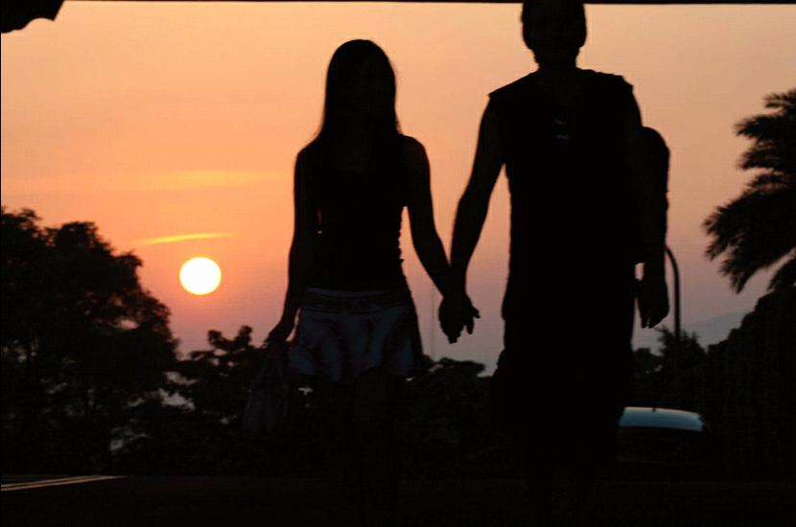
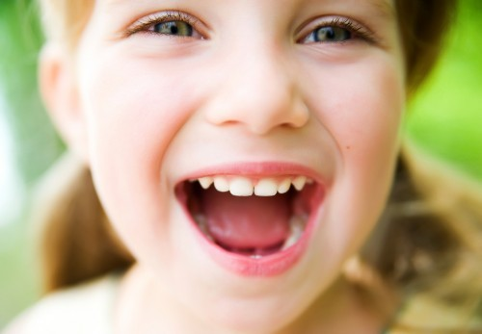

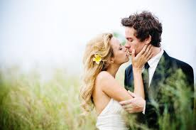
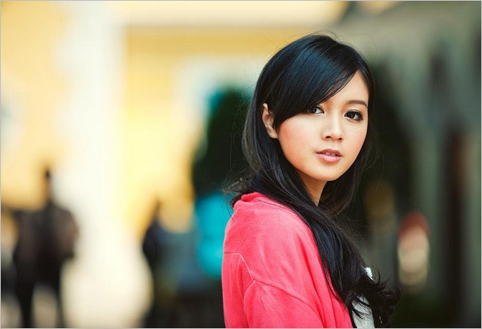
Introduction

Slide 5
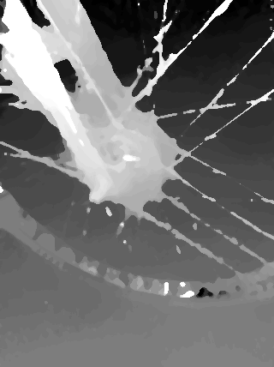
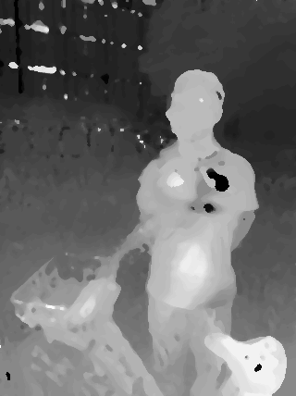
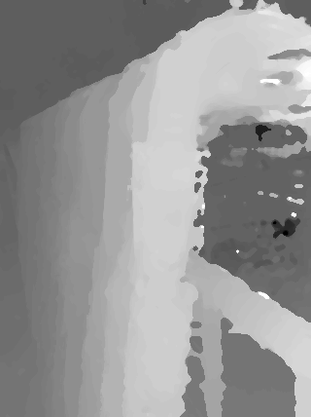
Result Preview

Slide 6

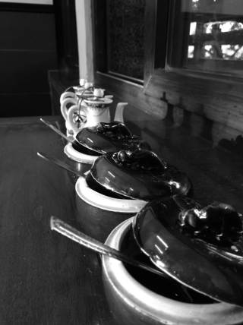
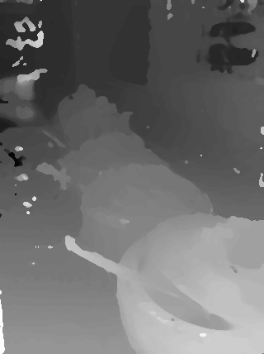
Method pipeline
Data preprocessing
Get max disparity
Census Hamming distance (+ SAD)
Intensity interpolation
Local voting
Bi-Layer Winner-take-all
Hole filling(?)
Weighted-median-
filter

Slide 7
Sub-Pixel
01
The structure is similar
02
The focal length is too long
03
The range of intensity is too limit
Intensity Interpolation
to increase structure information

Slide 8
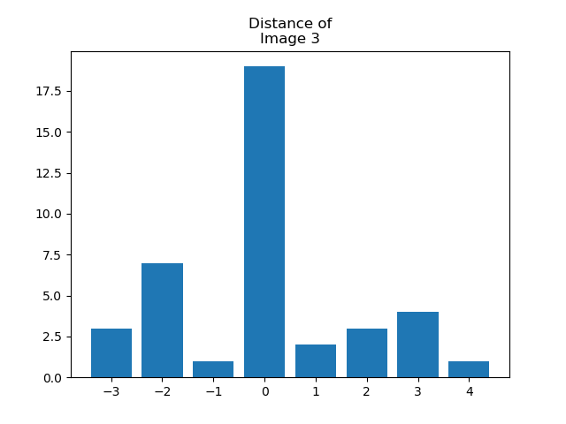
Sub-Pixel Cont.

Slide 9

Blur !
CUTE！ ATTENTION！
01
02
03
Determine max disparity
Get ratio between max disparity and SIFT
Scaling of interpolation

Slide 10
Left-Right Scanning
01
Some distance of keypoints are negative
02
The infinite points are not the same
03
The images are cross together
Left-Right Scanning
to get the cost between foreground and background

Slide 11
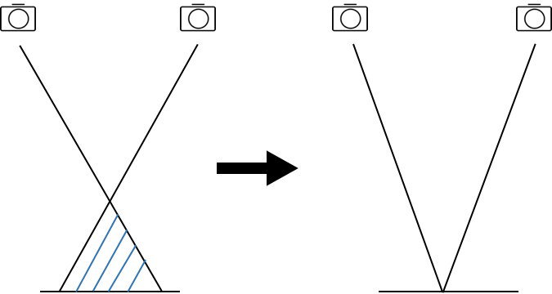
Left-Right Scanning Cont.

Slide 12
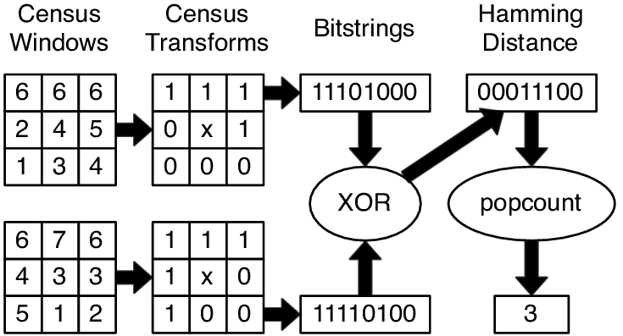
Census Transform
Reference: Pragma based parallelization - Trading hardware efﬁciency for ease of use?, Tobias Kenter

Slide 13
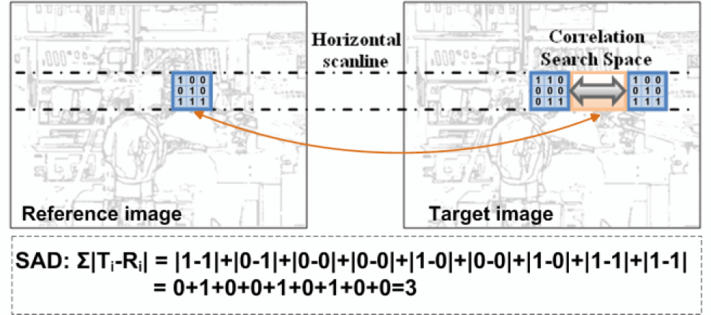
Block SAD
Reference: http://doi.ieeecomputersociety.org/cms/Computer.org/dl/trans/tc/2013/04/figures/ttc20130406904.gif

Slide 14
Bi-Layer Winner-take-all
0
-1
1
-2
2
-3
3
-4
4
-4
-3
-2
-1
0
1
2
3
4
rearrangement Winner-Take-All

Slide 15
Local voting
Resize before winner-takes-all, and do voting by scale.
Scale by 5
- Sum
- Min
- Median

Slide 16
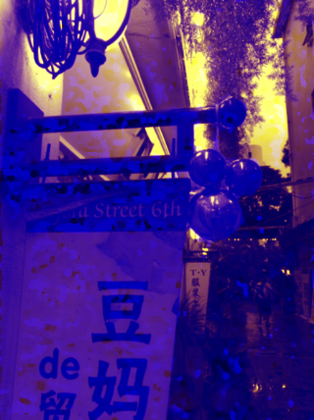
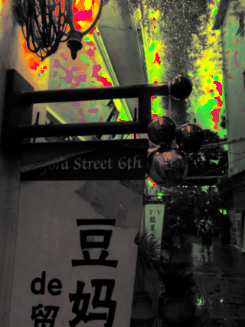
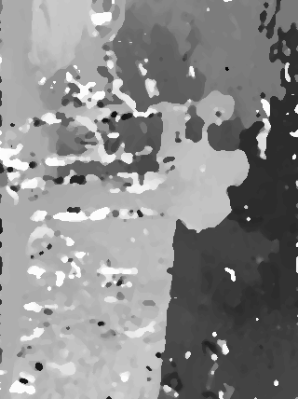
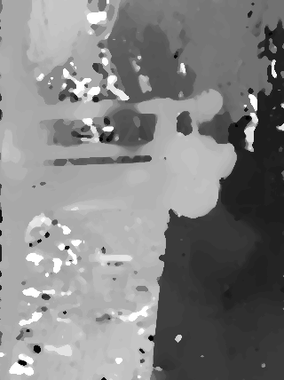
Color space transformation
Use the disparity map from winner-take-all with first channel
Use the original one channel picture normalize square with second channel
Use the original one channel picture with third channel
Change color space from HSV to RGB with cv2.COLOR_HSV2RGB_FULL
Use this as guide img to do weighted-median-filter

Slide 17
Future Refinement
01
Clustering each object and filling hole
02
Filling the hole of neighborhood of each disparity number
03
Hole filling by background and foreground disparity map
Time limitation

Slide 18
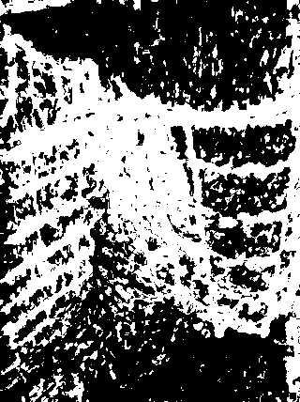
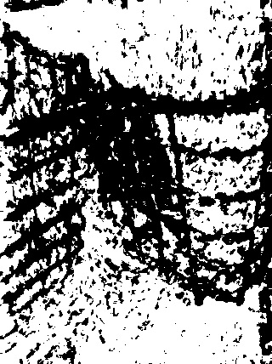
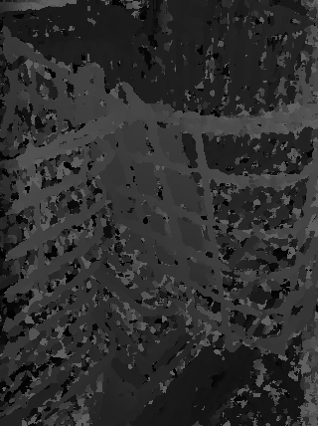
Future Refinement
Foreground
background
Before filling

Slide 19
Synthetic method
01
Using PSMNet deep learning model
02
Training on SceneFlow dataset
FlyTing3D
03
Fine tune on our final datasets

Slide 20
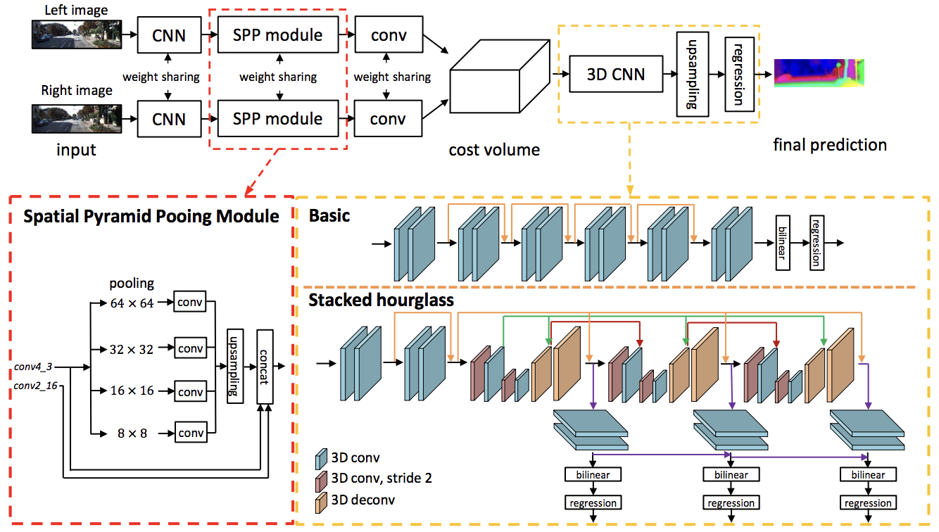
Model Structure
Reference: https://arxiv.org/pdf/1803.08669.pdf

Slide 21
Disparity Map Result

Slide 22
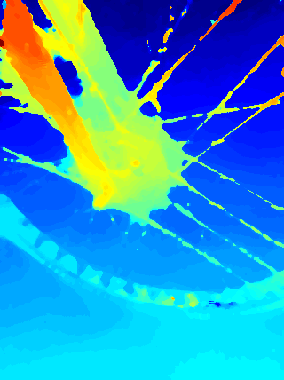
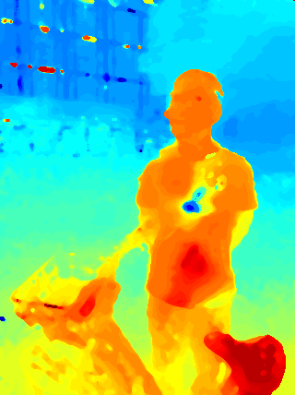

Slide 23
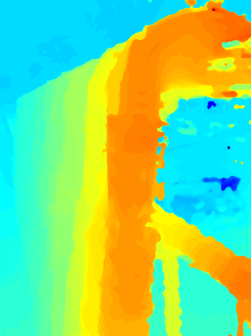
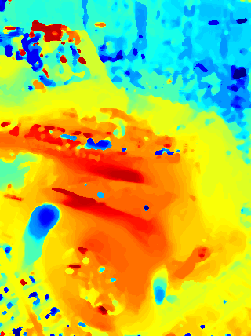

Slide 24
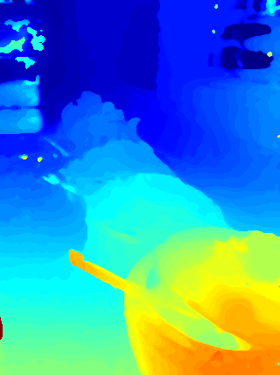
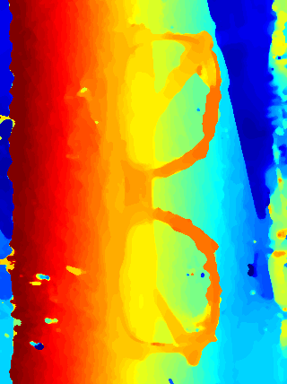

Slide 25
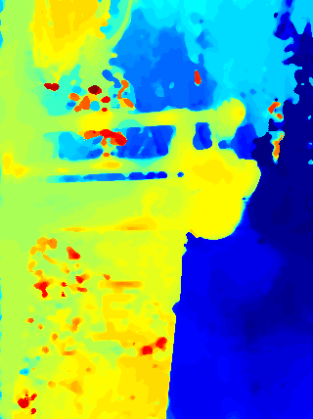
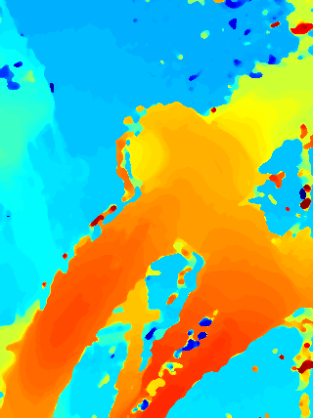

Slide 26
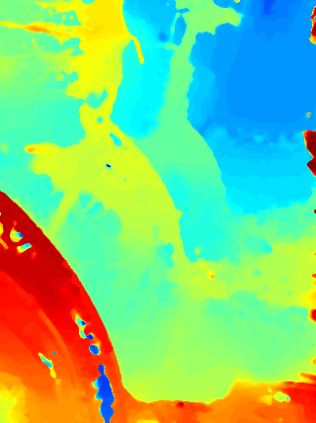
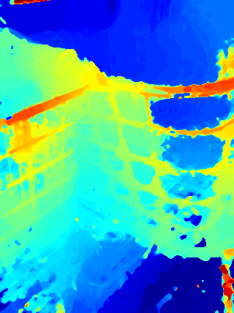

Slide 27
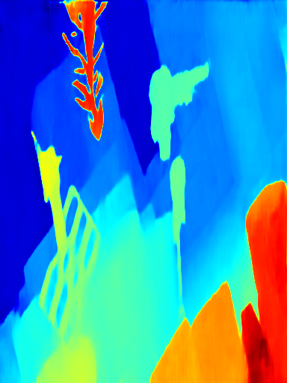
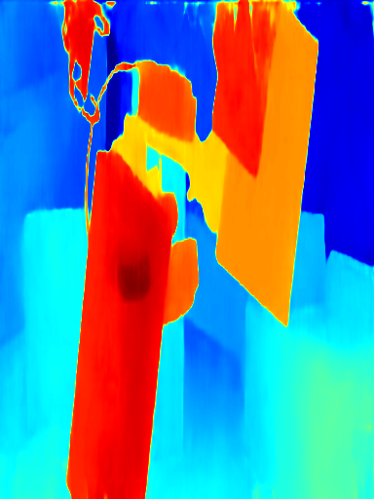
0.696
0.698

Slide 28
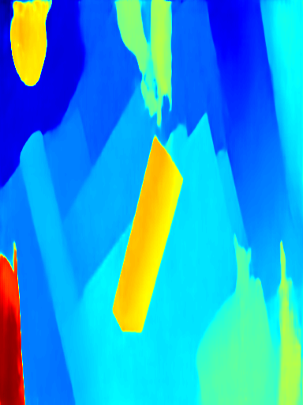
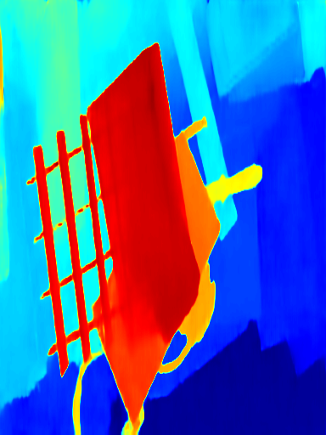
0.698
0.747

Slide 29
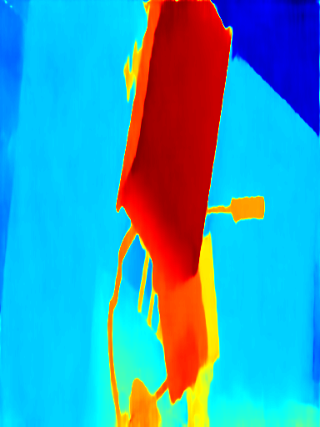
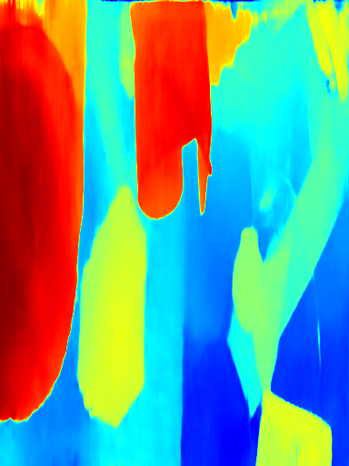
0.687
0.779

Slide 30
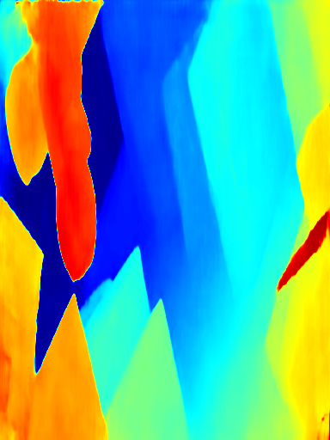
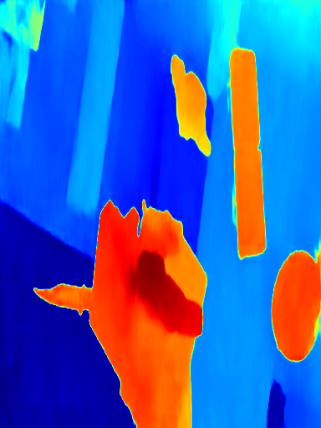
0.623
0.75

Slide 31
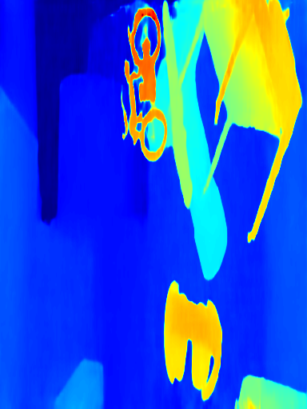
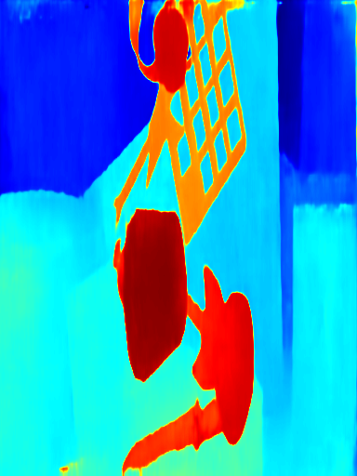
0.87
0.765

Slide 32
Thank You !

